Slide 1
Digitization of Estate Planning and Planning with Digital Assets
Fox Valley Estate Planning Council
Anne Stacey and Morgan Turner

Slide 2
Agenda
Current status of electronic signatures and electronic wills
State overview
Wisconsin
Digital Property Act
Cryptocurrency 101
Planning for digital assets

Slide 3
Traditional Estate Planning
Benefits of traditional way of creating an estate plan and executing estate planning documents
Writing clarifies testator’s wishes
Witness reinforces gravity
Witnesses shield testator from fraud or coercion
Formalities created

Slide 4
Challenges
Digital world
2020 pandemic

Slide 5
Evolution of estate planning
Electronic signatures
Electronic Wills
Remote and virtual probate

Slide 6
UETA and ESIGN
Uniform Electronic Transactions Act (UETA, 1999)
Electronic Signatures in Global and National Commerce Act (ESIGN, 2000)
Federal law
Provide uniform rules governing electronic commerce transactions
Wills are excluded.

Slide 7
Uniform Electronic Wills Act (UEWA)
Created by Uniform Law Commission
Requirements
Will must be in text format
Testator must sign the will or direct someone to do so for them (person must be physically present with testator).
Two witnesses must observe the testator's signature. They then add their own digital signatures to the document.
North Dakota and Utah have adopted

Slide 8
Electronic Wills in the United States

Slide 9
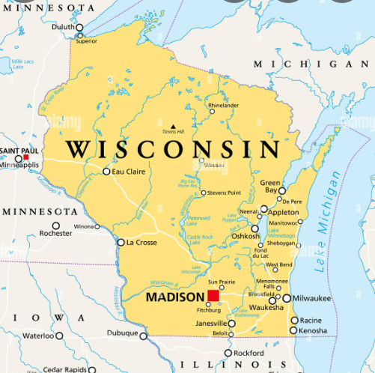
Wisconsin
WI Act 125
March 2020, allowed remote notarizations
Emergency request by WI State Bar Real Estate, Probate and Trust Law Section
May 2020, Wisconsin Supreme Court declined to allow remote witnessing

Slide 10
What is Digital Property? “An electronic record in which a person has a right or interest” Wis. Stat. 711.03(10)
Online bank, investment, brokerage, retirement, or other financial accounts Email Social media accounts File storage and sharing accounts (iCloud, Google Drive, Dropbox, Google Photos) Online store accounts (Amazon, PayPal, eBay) – with saved credit card information Rewards accounts (hotels, airlines, shopping, restaurants) Electronic bill payments Paperless credit card accounts | Information/data stored on computer, phone, tablet, other digital devices Electronic communications: email, text messages, instant/direct messages Web domains, domain registration/service accounts for websites Online memberships Entertainments accounts like Netflix, Hulu, etc. Accounts with automatic renewal or payments such as insurance policies, virus protection accounts, tuition payments for kids/grandkids schools, church and other charitable contributions, newspapers, etc. And more!

Slide 11
Wisconsin Digital Property Act
Chapter 711 of the Wisconsin Statutes, effective April 1, 2016
46 States have adopted a version of the Uniform Fiduciary Access to Digital Assets Act (UFADAA) or Revised UFADAA
Purposes of the Act:
Allow directions to custodians (such as Google, Facebook, etc.) to disclose or not disclose your digital property to your fiduciaries
Enable your fiduciaries to carry out your intent with respect to your digital property
Helps fiduciaries, practitioners and courts handle digital property similar to physical property
Primary focus of the Act is to enable your fiduciaries to have access to your digital property

Slide 12
Wisconsin Digital Property Act
The Act governs the disclosure of a person’s digital property to their fiduciaries by a custodian
Act’s Default Rules for Disclosure of Digital Property to Fiduciaries:
Fiduciary will have access to a catalogue of your electronic communications and all digital property
Your fiduciary will not have access to the content of your electronic communications unless you have affirmatively authorized such access
Catalogue versus Content
Estate planning instruments can modify default rules
Dealing with Cryptocurrency as a Digital Asset

Slide 13
Cryptocurrency
What is it?
How is it valued?
Tax treatment and implications of transfer
Estate planning considerations

Slide 14
What is cryptocurrency
Any form of currency that exists digitally or virtually and uses cryptography to secure transactions. Cryptocurrencies don't have a central issuing or regulating authority, instead using a decentralized system to record transactions and issue new units.
Examples: Bitcoin, Ethereum, Litecoin, Ripple

Slide 15
How does cryptocurrency work?
Supported by blockchain technology
Records transactions
Called coins or tokens
Units of exchange for goods or services, stored for value, or used in specific software programs

Slide 16
How to buy and what can you buy?
How?
Choose platform, fund, place an order
What?
Investment tool
Online purchases: Tech products- AT&T, Microsoft
Overstock, shopify, Home Depot, Rakuten
Watches or cars- Rolex, Audi, BMW, Nissan and Toyota

Slide 17
How is cryptocurrency valued and taxed?
Crypto price essentials
Price is determined by the relationship between supply and demand.
The total amount of most cryptocurrencies is limited by max supply.
Tax implications
Treated like property, not currency
Gains treated by IRS the same way it treats any kind of capital gain
Short term vs. long term

Slide 18
Practical Problems for Dealing with Digital Property on Disability and Death
Problem 1: Knowledge and Discovery of Digital Property
Utilize Digital Inventory
Problem 2: Authority to Access Digital Property
Largely addressed by Digital Property Act
Note difference for content of electronic communications
Problem 3: Ability to Access Digital Property
Utilize Digital Inventory
Securing Digital Inventory

Slide 19
Disposition of Digital Property on Death
Digital Property List (similar to Tangible Personal Property List) incorporated by reference into a Will or Revocable Trust
Washington Will Provision
Transfer on Death by Online Tool
Wis. Stat. 705(10) updated to include “online tool” in the list of instruments which may contain a provision for nonprobate transfer on death.
“Online tool” is defined by the Digital Property Act as “a setting provided by a custodian that allows the user, by an agreement between the custodian and user that is distinct from the user’s assent to the terms of service, to provide directions for disclosure or nondisclosure of digital property to a designated recipient.” Wis. Stat. 711.03(18)

Slide 20
Estate Planning for Cryptocurrency as an asset
Challenges for planning with cryptocurrency
Account titling
Access to the cryptocurrency
Options
Private keys with fiduciary
3rd party
Digital asset list/inventory
Disposition planning and gifting

Slide 21
Best Practices
Password Collection and Management
Password managers
Master password
Paper: old fashioned, less secure
Digital Audit
Expand estate planning questionnaire to inquire about digital property
Digital property list and password inventory
Educate Clients on Digital Property

Slide 22
Sample Language for Fiduciary Authority re: Digital Property
Short form: “to access, modify, delete, control, transfer and otherwise deal with my digital assets, property and accounts to the fullest extent possible regardless of the physical location of such asset, property, or account or the device on which it is stored or hosted and my personal representative is authorized to obtain, access, modify, delete, and control my passwords and other electronic credentials, logins, and security questions/answers associated with such digital assets, property, and accounts.”
Long form: “to find, access, modify, copy, delete, manage, protect, distribute, dispose of, transfer, transfer ownership rights in, terminate, decrypt, or otherwise control any (i) digital devices and any digital property stored thereon regardless of the physical location of such device; (ii) digital accounts, including the content of electronic communications regardless of the location of such account or the device on which it is stored, hosted, or otherwise accessible; and (iii) digital property owned by either of us or that either of us otherwise possess rights to, including the content of electronic communications regardless of the ownership of the digital device on which the digital property is stored or the ownership of the digital account within which the digital property is stored. The trustees are specifically authorized to obtain, access, reset, recover, delete, and control passwords and other electronic credentials, logins, and security questions/answers associated with such digital devices, accounts, and/or property, and to contract or communicate on behalf of either of us with any person or entity that stores digital property or information, and to protect and preserve any intellectual property rights of either of us in digital property. “Digital devices” include, without limitation: any type of computer or computing device; mobile or smartphones; and any similar digital or electronic storage device or medium either currently in existence or that may exist as technology develops. “Digital accounts” include, without limitation: any online account and any similar or comparable digital accounts currently in existence or that may exist as technology develops. “Digital property” includes, without limitation, emails, digital files, photos, videos, or audio files; software licenses; domain registrations; digital account balances/credits; the content of all digital accounts; and any other digital property either currently in existence or that may exist as technology develops. “Digital content” includes, without limitation, electronically stored information or other similar content, and any other digital media currently in existence or that may exist as technology develops. The authority granted to the trustees under this paragraph shall be construed broadly, and to the extent permitted by law shall be considered or deemed to be our consent for all purposes of the Electronic Communications Privacy Act: Stored Communications Act, 18 U.S.C. §§2701-2711 and the Computer Fraud and Abuse Act, 18 U.S.C. §1030, as amended.”

Slide 23
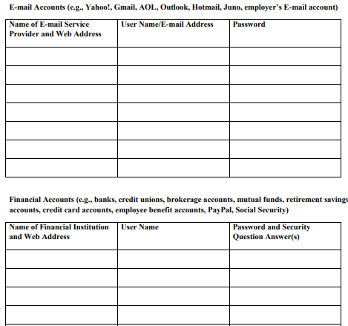
Digital Inventory List - Example

Slide 24
Questions?

