Slide 1
Trust & Estate Practical Potpourri
Keith Depies, CPA

Slide 2
Estate and Trust 101(ish)
Form 1041 – General
Comments and Helpful Hints
Putting it Together - Planning with specific types of Trusts

Slide 3

Alphabet Soup

Slide 4
Alphabet Soup
HEET
QPRT
CRAT
QSST
BDIT
ESBT
IDGT
GRAT
SNT
QRT
ESOP
CRUT
CLAT
ILIT

Slide 5

Estate Planner’s Toolbox
What does yours look like?

Slide 6
What Could Client Goals Be?
Estate tax avoidance/minimization
Income tax efficiency
Asset protection (divorce, at-risk beneficiary, etc.)
Flexibility
Control
Family harmony
Transition business or other asset
Simplicity
How do you keep it all straight?!

Slide 7
Estate and Trust 101

Slide 8
Simple Trust
    Required to distribute all “fiduciary accounting income” to beneficiaries.
    Trust language such as “all income must be distributed at least annually.”
    $300 exemption.
    Only pays tax at the trust level on capital gains…generally.
    Considered complex trust in any year that distributions exceed accounting income, but still receives $300 exemption.

Slide 9
Complex Trust
    Not required to distribute all income.
    Trust language such as “any income not distributed is added to principal.”
    $100 exemption.
    Trust will pay taxes on net income not passed out to beneficiaries.

Slide 10
Grantor Trust
    Anytime the grantor has the power to change, revoke, amend, etc. the terms of the trust.
    However, there are many other more subtle trust provisions that may make a trust a grantor trust.
    IRC 671-678: Any one power will do the trick.
    THESE ARE INCOME TAX PROVISIONS.
    All income and expenses flow to grantor to report on 1040.
    Issue grantor letter vs. K-1 and don’t complete rest of 1041.
    Why does this matter? Do you have ANY S Corp clients??

Slide 11
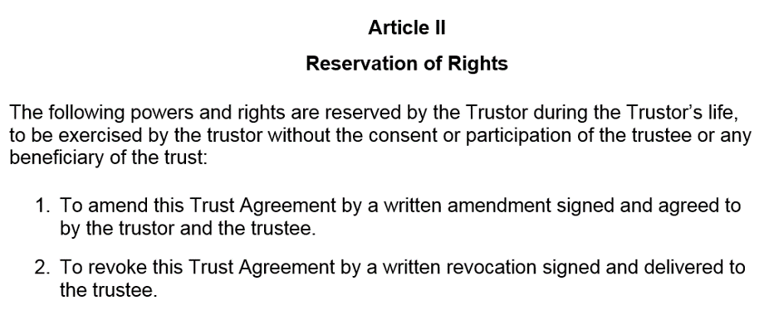
Sample Grantor Trust Language
676(a)
We’ll revisit this later…

Slide 12
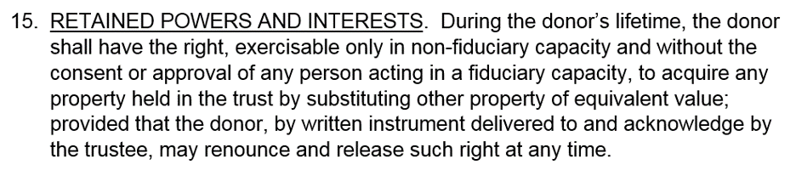
Sample Grantor Trust Language
675(4)(c)
We’ll revisit this later…

Slide 13
S Corporations and Trusts
  Only select trusts are qualified S shareholders - IRC 1361.
  Need to read documents to be sure - Don’t just look at the title of trust.
  1361 identifies which trusts qualify:
    Voting trusts, which are created primarily to exercise the voting power of the owned stock. Sec. 1361(c)(2)(A)(iv). Each beneficiary of the trust is considered to be a shareholder for purposes of the 100-shareholder limitation.
    Testamentary trusts that receive S stock pursuant to the terms of a will (but, in general, eligibility is limited to a two-year period of ownership). Sec. 1361(c)(2)(A)(iii). The estate is considered to be the shareholder for purposes of the 100-shareholder limitation.
    Grantor trusts of which all income and corpus is treated as being owned by a U.S. citizen or resident. Sec. 1361(c)(2)(A)(i). The deemed owner is considered to be the shareholder for purposes of the 100-shareholder limitation.
    Trusts existing before death that met the grantor trust requirements of item 3 and that continue to exist after death (although eligibility is limited to a maximum two-year period of ownership). Sec. 1361(c)(2)(A)(ii). The estate is considered to be the shareholder for purposes of the 100-shareholder limitation.
    Qualified Subchapter S trusts (QSSTs) that own stock in one or more S corps and are treated as trusts described in item 3. Sec. 1361(d). The income beneficiary is considered to be the shareholder for purposes of the 100-shareholder limit.
    Electing small business trusts (ESBTs) that own stock in one or more S corps. Sec. 1361(c)(2)(A)(v). Each potential current beneficiary is considered to be a shareholder for purposes of the 100-shareholder limitation.
    Certain tax-exempt qualified retirement plan trusts or organizations under IRC Sec. 408(a), 408A, 501(c)(3), or 501(a). Sec. 1361(c)(2)(A)(vi) and 1361(c)(6).

Slide 14
Split-Interest Trusts
    Charitable remainder trusts (CRUT or CRAT).
    Charitable lead trusts (CLAT or CLUT).
Aren’t all trusts (by definition) split interests?

Slide 15
Decedent’s Estate
    Taxed similar to complex trust (estate will pay taxes on all net income not passed out to the beneficiaries).
    $600 exemption.

Slide 16
Considerations for Deceased Taxpayers
    Due date for final 1040 same as usual, with extension.
    Review possible RMDs for correct treatment.
    Apply for any applicable EINs.
    File form 56 – Notice Concerning Fiduciary Relationship.
    Valuable elections to have handy: 454, 645, 754.

Slide 17
Section 454 Election
    Elect to recognize deferred interest income on Series E & EE bonds on the final personal income tax return.
    Consider tax rates of decedent and those of heirs or trusts that may be the ones cashing in bonds after death.
    Consider if large (medical) deductions on final 1040 and/or lower income (e.g. death in January).

Slide 18
Section 645 Election
    Form 8855 (used to be written election).
    Election to combine a qualified revocable trust and estate for income tax purposes.
    Code return as “decedent’s estate.”
    No estimates required for two years.
    Allowed to hold S Corporation stock.
    Can elect fiscal year-end (only available to estates), which may defer beneficiaries reporting of income on their 1040s.

Slide 19
Section 754 Election
    Elect to adjust the inside basis of a partnership to equal the outside basis.
    Does NOT apply to S Corporations….so what happens?

Slide 20
Why it matters
2023 Rates and Exemptions
Tax rate | Single | Head of household | Married filing jointly or qualifying widow | Estates and Trusts
10% | $0 to $11,000 | $0 to $15,700 | $0 to $22,000 | $0 to $2,900
12% | $11,001 to $44,725 | $15,701 to $59,850 | $22,001 to $89,450
22% | $44,726 to $95,375 | $59,851 to $95,350 | $89,451 to $190,750
24% | $95,376 to $182,100 | $95,351 to $182,100 | $190,751 to $364,200 | $2,901 to $10,550
32% | $182,101 to $231,250 | $182,101 to $231,250 | $364,201 to $462,500
35% | $231,251 to $578,125 | $231,251 to $578,100 | $462,501 to $693,750 | $10.551 to $14,550
37% | $578,126 or more | $578,101 or more | $693,751 or more | $14,451 or more
Exemption or Standard Deductions | $13,850 | $20,800 | $27,700 | 100/300/600

Slide 21
Estate and Trust 101
    Trusts: Must (usually) have tax year-end of December 31.
    Estates: Can elect fiscal year up to last day of month preceding date of death.
    Revocable Trusts (Living Trusts): Are generally filed as part of the grantor’s 1040, upon grantor’s death; the trust then becomes irrevocable and needs to file its own return (or elects to be combined with the estate).
    Qualified Revocable Trusts: With 645 election, can elect fiscal year using estate rules.
      Query: what if no estate? Should it have an EIN?
      Do you trust IRS/WI to treat correctly?
    Terminating Year: Tax year ends on last day of month for which administration is complete (assets distributed, etc.).

Slide 22
Reviewing the Trust Document
    Proper entity classification (tax status).
    Correct trustees and beneficiaries.
    Allocation of income and expenses between income and principal.
    Allowable principal distributions.
    Trust terminating/changing events (age, event, etc.).
    Separate share requirements.
    Need for disinterested or adverse trustees for certain transactions.

Slide 23
Fiduciary Accounting Income - Schedule B
    Income determined based on the provisions of the governing document and applicable local law. Only includes the income portion of allocated income and expenses.
    Determines the economic interests of the income and remainder beneficiaries.
    Allocate income and expenses between the trust’s income, which may be distributed to the income beneficiary, and the principal, which will eventually be distributed to the remainder beneficiaries.
    Not tax or GAAP.
    Special attention should be paid to pass-through assets.

Slide 24
ATI – Adjusted Total Income - Page 1
    Taxable income before the income distribution deduction and exemption.
    Includes both the income and principal portions of allocated income and expenses.

Slide 25
DNI – Distributable Net Income Schedule B
    Begins with ATI.
    Basically, taxable income computed with the following modifications:
    No distribution deduction for amounts distributed to beneficiaries
    No personal exemption deduction
    Capital gains are generally excluded from DNI
    Used to limit the income distribution deduction (amount of beneficiary distributions allowed as a deduction in arriving at taxable income) allowed for determining the trust taxable income.
    Distribution deduction limited to the lesser of total distributions less Tax Exempt income or DNI less Tax Exempt income.

Slide 26
XYZ Trust Example
A complex trust with $28,000 of distributions to primary beneficiary
Interest Income |  | 5,000.00
Dividend Income |  | 20,000.00
Capital Gains |  | 6,000.00
Total Income |  | 31,000.00
Trustee Fees |  | 4,000.00
Legal and Accounting |  | 1,000.00
Investment Management Fees |  | 3,000.00
Total Expense |  | 8,000.00
 | ATI |  | Accounting Income |  | DNI |  | Taxable Income
Interest Income | 5,000.00 |  | 5,000.00 |  | 5,000.00 |  | 5,000.00
Dividend Income | 20,000.00 |  | 20,000.00 |  | 20,000.00 |  | 20,000.00
Capital Gain | 6,000.00 |  | - |  | - |  | 6,000.00
Trustee Fee | (4,000.00) |  | (2,000.00) |  | (4,000.00) |  | (4,000.00)
Legal and Accounting | (1,000.00) |  | (500.00) |  | (1,000.00) |  | (1,000.00)
Investment Management | - |  | (1,500.00) |  | - |  | -
Exemption | - |  | - |  | - |  | (100.00)
Distribution | - |  | - |  | - |  | (20,000.00)
Calculated Amount | 26,000.00 |  | 21,000.00 |  | 20,000.00 |  | 5,900.00

Slide 27
Preparing the Return
6012(b) Statement (Footnote to Return):
    Statement made when multiple fiduciaries are appointed but only one is signing return.
663(b) Election:
    Elect to have distributions made within 65 days of tax year-end to be treated as being made within the previous taxable year.
    Only applies to complex trusts or estates, not simple trusts.
    Page 3, line 6, check box.

Slide 28
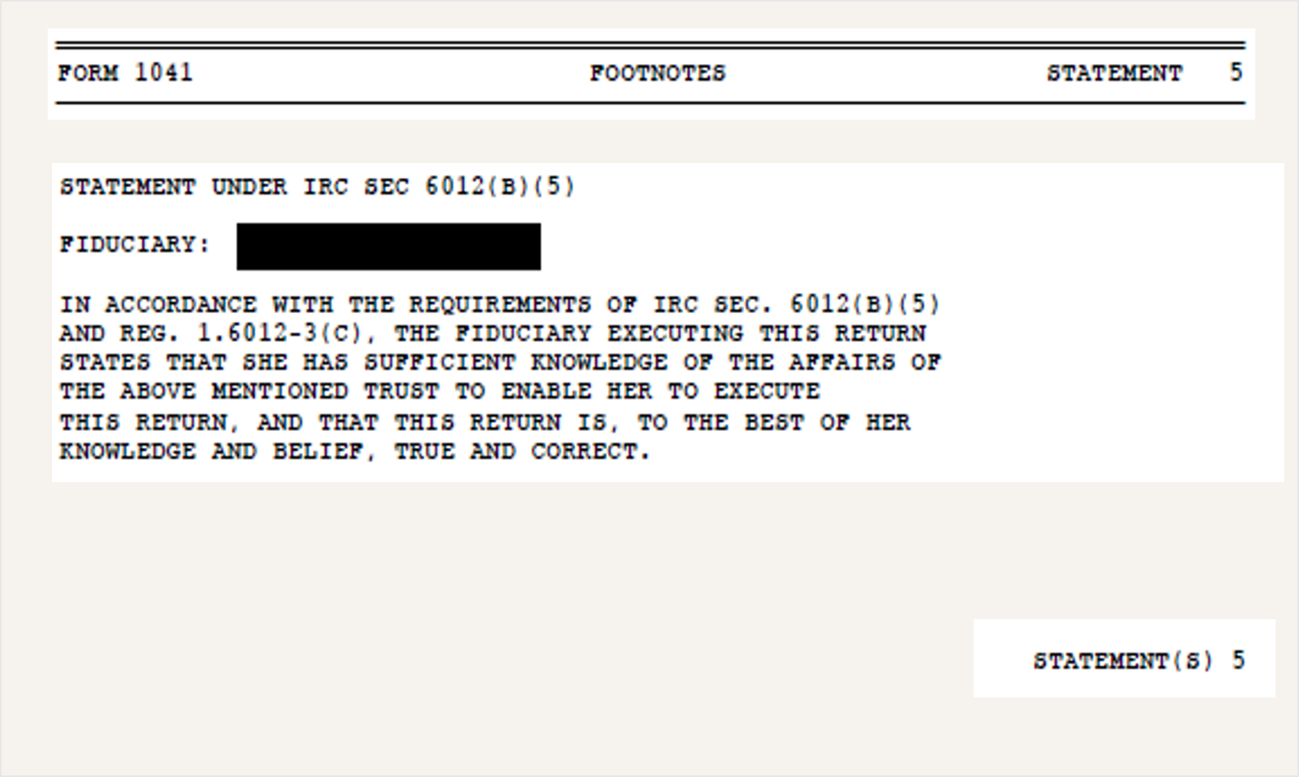
Preparing the Return
Example: 6012(b) Statement (Footnote to Return)

Slide 29
Estimated Tax Payments
    Initial-year trusts may require estimates; second-year trusts cannot be protective based on the initial year unless the initial return covered the full year.
    Estates: not required for initial 2 years (recall 645 election).
    Consider each state separately.
    WI safe harbor exception, but not always.
    IL is great!
    CA is not!

Slide 30
Preparing the Return
    1041-T: Allocate trust estimates paid to beneficiary (not available in every state).
    Extensions:
  Form 7004 (some states have their own too)
  Determine if any state extensions are needed
  Extended due date is now 9/30 for 12/31 filings
  Some returns (Form 5227) also have separate extensions and not all can be e-filed.

Slide 31
State Considerations
    Review the instructions for any state in which the trust originated (grantor lives or died), or where the trustee lives, or where any beneficiaries live.
    Fiduciary law varies from state to state in how it taxes a trust.
    In some cases, a trust may not be taxed in any state, while in other cases, it may be taxed in multiple states, even if it doesn’t own property in multiple states.
    Credit for taxes paid if multiple states tax same income.

Slide 32
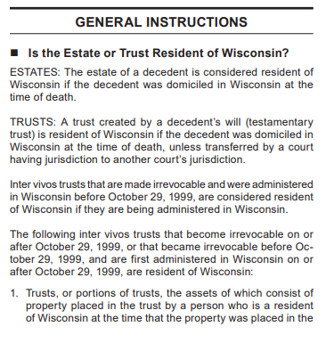

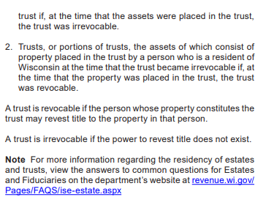
State Considerations

Slide 34

State Considerations
    Long-arm statutes – see WI flowchart handout:
      IL: Linn case (2013).
      MN: Fielding case (2017).
      WI: not challenged (yet).
    Consider subscription services for charts

Slide 35
Putting It Together

Slide 36
Power to Revoke
Let’s Look at This Again…
676(a)

Slide 37
Putting It Together
Income Tax
Estate/
Gift Tax
676(a)2038
Symmetry in laws.

Slide 38

Power to substitute
Let’s Look at This Again…
675(4)(C)

Slide 39
Putting It Together
Income Tax
Estate/
Gift Tax
675(4)(C)
N/A
Planning Opportunity?

Slide 40
Putting It Together
Income Tax
Estate/
Gift Tax
Client Goals
Create Value

Slide 41
Included in Estate
Excluded from Estate
Techniqu
es:
Techniques:
-
Living/revocable trusts (2036 inclusion)
-
Irrevocable life insurance trusts (ILIT)
-
Transfer/payable on death provisions
-
Grantor retained annuity
trusts (GRAT)
-
Marital/community property agreements
-
Defective grantor trusts (IDGT)
Goals:
-
Grantor charitable lead annuity trusts (CLAT)
-
Basis step up/down
-
Beneficiary defective trusts (BDT)
-
Maintain control and flexibility
-
Spousal lifetime access trust (SLAT)
-
Maintain income and cash flow
-
Dynasty trusts (grantor)
-
Qualified personal residence trust (QPRT)
Other consi
derations:
Goals:
-
Generally, no 709 required since incomplete gift.
-
Maximize wealth transfer
Assets to fund with:
-
Leverage lifetime exclusion amount(s)
-
Any but be mindful of IRA and other qualified plan assets if named as
-
Maintain flexibility
and
cash flow
beneficiary of plan.
-
Generation skipping (some but not all of above)
-
Additional transfers via grantor trust status
(i.e. sales).
-
Creditor protection
Other considerations:
-
Gener
ally, 709 required.
Assets to fund with:
-
Any, but not assets that grantor will use personally unless rent paid.
-
Higher growth is best.
-
Typically used for closely
-
held business interests.
Techniques:
Techniques:
-
Incomplete non
-
grantor trusts (ING)
-
Irrevocable gift trusts
-
Dynasty trusts (non
-
Goals:
-
Non
grantor)
-
-
Basis step up/down
grantor charitable lead annuity trusts (CLAT)
-
Maximize SALT deductions
Goals:
-
Enhance 199A attributes
-
Leverage lifetime exclusion amount(s)
-
Creditor protection
-
Generation skipping
Other considerations:
-
Creditor protection
-
Generally, 709 required.
Other considerations:
Assets to fund with:
-
Generally, 709 required.
-
Assets that generate state taxable income.
Assets to fund with:
-
Consider preservation of basis step up.
-
Any, but not assets that grantor will use personally unless rent paid.
-
Typically used
with closely
-
held pass
-
through entities for 199A purposes.
-
Higher growth is best.
Note: this summary is designed for high level
planning discussions only
-
consult a specialist for detailed discussion and modelling of specific scenarios

Slide 42
What Could Client Goals Be?
Estate tax avoidance/minimization
Income tax efficiency
Asset protection (divorce, at-risk beneficiary, etc.)
Flexibility
Control
Family harmony
Transition business or other asset
Simplicity

Slide 45
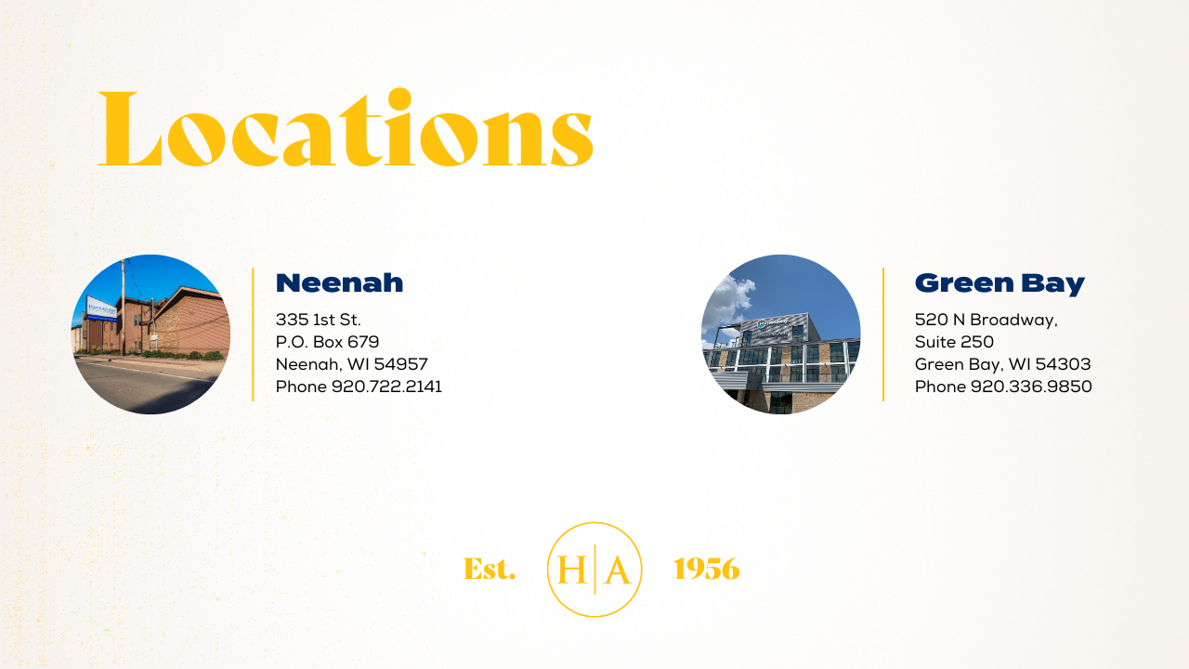

Slide 46


Contact Us
Keith Depies,
CPA
Ryan Laughlin,
CPA, MST, JD, AEP
Partner
Direct: 920.722.2141
kdepies@ha.cpa
Partner
Direct: 920.337.4525
rlaughlin@ha.cpa

